Slide 1
Persuasive Appeals
The 3 most common techniques to persuade readers to see your point of view.
These appeals can be used in writing, speaking, and advertising.

Slide 2
Ethos (or ethical appeal) Using the source's credibility or authority to persuade you. We believe people that we respect and that we believe to be an authority on the topic.

Slide 3


Ethos
Do you trust and idolize these athletes? The brands they support become popular because fans believe they are credible.

Slide 4
Logos (or logical appeal)
Using logic to support a claim and persuade.
Can also be the facts, data and statistics used to help support the argument.

Slide 5

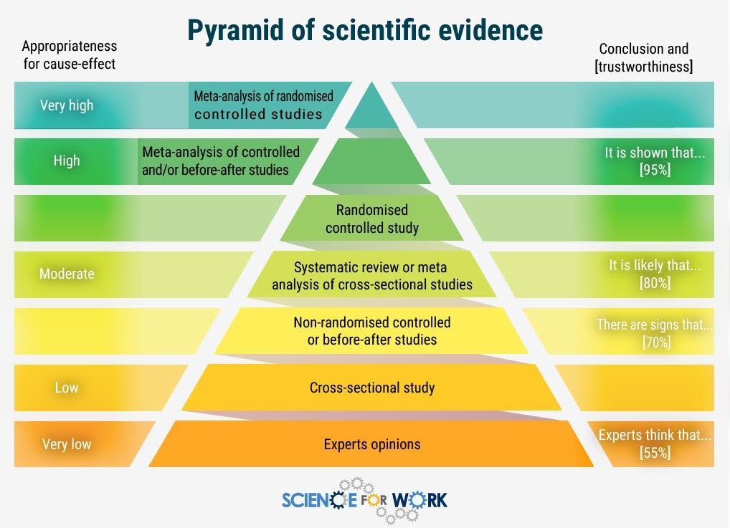
Logos
Scientific evidence serves as proof.
It seems undisputable.

Slide 6
Pathos (emotional appeal)
Tugging at the emotions of someone to persuade or motivate.
Use of vivid language, emotional language and numerous sensory details.

Slide 7


Pathos
Emotions such as guilt, sympathy, responsibility, and fear can be very effective in convincing others.

